Slide 1
Operating System Scheduling
OS Scheduling for Real Time Systems
  Operating System Priority
  Pre-emptive Scheduling
  Rate Monotonic Scheduling
©Paul Davies 2020. Not to be copied, used, or revised without explicit written permission from the copyright owner. This lecture may contain animations and is best viewed as a slide show

Slide 2
The Concept of Task Priority and Pre-emptive Scheduling
All operating systems assign numerical priorities to tasks to indicate their relative importance in the system.
Priority is used by the OS to decide which task should be running at any instant.
(The priority of a task is generally assigned during its creation - See CProcess and CThread etc. but can generally be changed later once the program/thread is running.)
A task with a high priority should always be scheduled to run in preference to a task with a lower priority when ever the higher priority task becomes active and is not blocked (e.g. not waiting on a semaphore or keyboard input etc.)
This means a high priority task should be able to pre-empt (i.e. displace) a low priority task whenever the high priority task is activated and not blocked.
This is particularly important when we consider Rate Monotonic Scheduling, (RMS), a popular scheduling strategy used by many real time operating systems to ensure tasks meet their deadlines (described later in this lecture).

Slide 3
Problems with Priority – Priority Inversion
A common problem that can arise in systems with task priorities is Priority Inversion.
  Imagine a low priority task L that has acquired some non-sharable resource via a mutex Wait().
  Some time later, a high priority task H is activated (resulting in the pre-emption of L).
  Image H now tries to acquire the same resource as L via a Wait() on the same Mutex. It will be blocked as it cannot steal the resource from L.
  H is thus pre-empted and L resumes.
  Finally a medium priority task M is activated (that is not interested in acquiring the resource). This leads to the pre-emption of L for as long as M is active.
  This means that a medium priority task M is indirectly blocking execution of a higher priority task H , even though their actions are independent (not blocking each other)
Acquires resource with a Wait()
low priority
pre-empt
Done
med priority
pre-empt
pre-empt
Done
high priority
Tries to acquires resource with a Wait(), but blocked by L

Slide 4

This situation is usually harmless, serving only to delay Task H slightly while Task M and then Task L complete (releasing the mutex).
However this situation lead to the problems with the Mars Pathfinder mission in 1997. Because H did not complete in time, a watchdog timer on the lander reset the system multiple times which could have jeopardised the whole mission (it was patched from earth).
See https://en.wikipedia.org/wiki/Mars_Pathfinder#On-board_computer

Slide 5
Solution in Real Time System: Priority Inheritance
The most common solution to priority inversion in RT systems, is through priority inheritance
When a lower-priority task blocks a higher priority task due to a shared resource, the priority of the lower task is temporarily raised by the OS to that of the blocked task.
Windows, which is not a RTOS and has limited numbers of priority levels, solves the problem by “randomly boosting the priority of low priority resource holders” until they release the resource that is blocking others, i.e. a poor solution.
L with HIGH priority continues to run in preference to M
Release resource
Acquires resource with a Wait()
low priority
Priority Raised to High
Priority Lowered
pre-empt
Done
med priority
pre-empt
pre-empt
Done
high priority
Tries to acquires resource with a Wait(), but blocked by L
Activated but not scheduled to run
See http://en.wikipedia.org/wiki/Priority_inversion and http://en.wikipedia.org/wiki/Priority_inheritance and
https://docs.microsoft.com/en-gb/windows/win32/procthread/priority-inversion?redirectedfrom=MSDN

Slide 6
Rate Monotonic Scheduling
(RMS)
A Scheduling Approach for
Real Time Systems

Slide 7
In the opening lecture of this course we noted that time-based systems were an important classification of real-time systems.
That is, there are a large number of real-time systems designed to carry out repetitive, i.e. periodic tasks at regular fixed time intervals.
C triggered for the 1st time
C triggered for the 2nd time
C triggered for the 3rd time
c1
c2
c3
0
10
20
30
40
50
60
70
80
90
100
110
120
Time ms
A Periodic Task ‘C’ being triggered every 50 ms

Slide 8

An Example – The Software for a Car Cruise Control
In order to maintain a steady vehicle speed, the software is triggered, roughly every 500msec, to monitor the speed of the vehicle and output a correction value to the throttle.

Slide 9
Let’s Introduce
Some Terminology related to Periodic Tasks

Slide 10
A Task's 'Period' is the time between successive triggering of the task e.g. 50mS.
It’s Deadline is the time available to produce the Response to the trigger
Generally the deadline must be shorter than the trigger period. That is, the task must have generated its previous response, before it is triggered again.
Although trigger period and deadline are independent of each other, for worst case scheduling analysis (and real time systems in general) we consider the deadline to be more important. Often we will simplify the analysis by assuming that the trigger period is equal to the shorter deadline.
Deadline of ‘C’ = 40ms
Deadline of ‘C’ = 40ms
c1
c2
c3
Period of ‘C’ = 50ms
Period of ‘C’ = 50ms
0
10
20
30
40
50
60
70
80
90
100
110
120
Time ms
A Periodic Task ‘C’ being triggered once every 50ms, with a deadline of 40ms

Slide 11
The Compute time of a task is the CPU time required to generate the response.
  Compute time <= Trigger Period or Deadline
Hard and Soft Deadlines
For a car’s cruise control, it would not matter too much if, due to system loading, it occasionally missed its deadline and only managed to correct the speed of the vehicle every say 600 - 1000ms.
If missing the occasional deadline is acceptable, then we say that the task has a soft deadline and it may not be too much of a problem. However many real-time systems (e.g. Micrium) are hard RT systems that have ‘hard’ deadlines which must be met each and every they are triggered or the system FAILS.
Compute time of C = 5ms
Compute time of C = 5ms
Compute time of C = 5ms
c1
c2
c3
Period of ‘C’ = 50ms
Period of ‘C’ = 50ms
0
10
20
30
40
50
60
70
80
90
100
110
120
Time ms
A Periodic Task ‘C’ requiring 5 ms of computing time

Slide 12
Analysis of the Cruise Control : Would it meet it’s Deadline?
It would not be too difficult for a ‘cruise controller’ to meet a 500ms deadline, since even with a very slow computer, the CPU could:-
  Read the speed using an Analogue to Digital Converter (ADC) (~200 us),
  Compare it with the desired set speed (~10 us)
  Output a correction value to the throttle via a Digital to Analogue Converter (DAC) (~50 us)
This yields a compute time for the cruise controller of just 260us each time it is triggered, which is considerably less than its trigger period or deadline of 500ms
In fact it would require just 0.05% of the CPUs processing power to deal with each triggering of that task, so we can safely assume that the cruise control software whenever triggered would always meet its deadline, assuming of course it were the only task running on the system.

Slide 13
Big Deal, So What?
What if there were other periodic tasks also running on the system, each with their own associated compute and deadline/trigger period times?
We cannot just assume that the CPU could devote all its available time to just running the cruise control. What if there were dozens of other periodic task running in the system. Could we guarantee that each would meet its own deadline?
Important Question for Hard Real Time Systems
Is it possible to analyse any given set of 'n' periodic tasks and guarantee with 100% certainty that each task could be scheduled to meet it’s deadline each and every time it is triggered?
Even if we can analyse these tasks and prove that in theory that meeting their deadline is possible, how do we make it happen? How do we get the OS to schedule those tasks, so that in practice they always meet their deadlines?

Slide 14
14
Question: How could we prioritise and schedule those tasks?
In order to successfully schedule a set of periodic tasks so that each meets their deadline, it may be necessary for a task to be pre-empted before its completion, only to resume it again later.
This is a bit like putting down one assignment that you have already started, but which is not due until next week, (i.e. it's low priority) in order to start and complete a new assignment you've just been given, which is due tomorrow (i.e. high priority), before returning to complete the first assignment (assuming of course that you have left enough time to complete both).
Solution: Schedule on the basis of shortest deadline = highest priority
This is the approach taken by Rate Monotonic Scheduling. (R.M.S), a static priority hard real time scheduling algorithm.
Static priority here means that you, the designer, assign non changing priorities for your tasks at compile time, based upon the trigger periods of your tasks.
A task with a shorter deadline should be assigned a higher priority which will ensure that under a pre-emptive OS, Task H (a high priority task) will always run in preference to Task L (with a low priority task).

Slide 15
15
Example Assignment / Schedulability Problem:
What if 3 course instructors on the first day of term state they will give you
    An assignment that takes 1 day to complete every 5 days.
    An assignment that takes 1.5 days to complete every 4 days.
    An assignment that takes 1 day to complete every 3 days.
Can you analyse these requirements right now, without knowing anything more about them and determine if it’s possible for you to meet these deadlines every week until the end of term?
Can you figure out how to schedule and prioritise your time, i.e. when to pick up and put down those assignments to ensure you meet the deadlines?
Can you figure out what task you should be working on at any point during the term and also when you would be idle (no assignment to work on)?
Would there be times of overloading where deadlines would be missed?

Slide 16
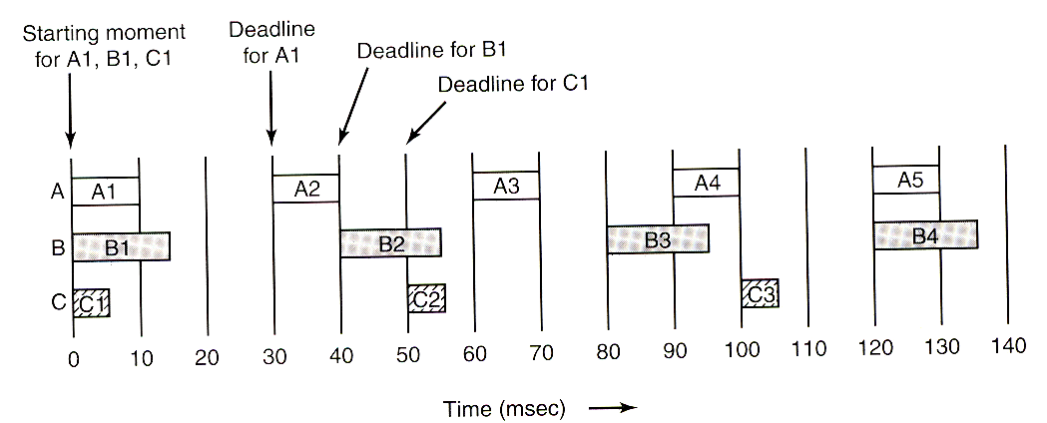
16
An Example Illustration
The illustration below shows an example system with 3 periodic tasks A, B and C all starting at the same time (the worst case scenario), and thereafter being triggered at 30, 40 and 50mS. Their deadlines are assumed to be the time until they are triggered again.
Each task has the following compute times { A=10, B=15 and C=5 mS }.
This means A consumes 10/30ms of the CPU time, B consumes 15/40ms and C consumes 5/50ms, giving a total of CPU Utilisation figure of 80.5% for all 3 tasks.
A consumes 33% of the CPU time
B consumes 37.5%
C consumes 10%
Total consumed by all = 80.5%
Deadline for A is 30ms
Deadline for B is 40ms
Compute time for A is 10ms
Compute time for B is 15ms
Compute time for C is 5ms
Deadline for C is 50ms

Slide 17
17
Statement of Problem
Is it possible to analyse this set of tasks (i.e. their deadlines and compute times) and thus determine if all tasks will always meet their individual deadlines.
If the answer is yes, how do we prioritise those tasks and get an OS to schedule each task to actually meet those deadlines?
A consumes 33% of the CPU time
B consumes 37.5%
C consumes 10%
Total consumed by all = 80.5%
Deadline for A is 30ms
Deadline for B is 40ms
Compute time for A is 10ms
Compute time for B is 15ms
Compute time for C is 5ms
Deadline for C is 50ms

Slide 18
18
There are two ways to analyse a set of periodic tasks to determine with 100% accuracy (i.e. guarantee) that they either will or will not always meet their own individual deadlines
  Draw a time line graph to show how you would perform the tasks in practice. We draw the graph until the start pattern, i.e. all tasks being triggered at the same time, repeats itself.
  If the graph shows that each task has always met its deadline within that repeating time frame, then it is guaranteed that each task in the set will always meet its deadline under any circumstances.
  We could analyse the set of tasks mathematically and show that it is possible for them to always meet their deadlines.
Approach 2 is the most desirable since it is quick but, as we shall see, does not always give us a definitive answer. Approach 1 is time consuming, but always gives us a dependable answer.

Slide 19
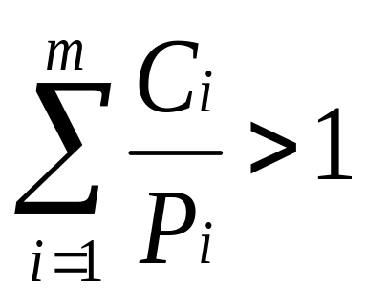
Mathematical Analysis
Liu and Layland showed in ’73 that as a first precondition, a set of ‘m’ tasks will definitely not meet their deadlines if the following expression is true.
Where
P_{i} is the Period (or Deadline whichever is least) between activations of task ‘i’.
C_{i} is the compute time required by ‘i’ to perform its task.
The ratio C_{i} / P_{i} is thus the fraction of CPU time used by task ‘i’. The above equation is simply a statement of the fairly obvious fact that if the tasks between them, consume more than 100% of CPU time, at some point they will fail to meet their deadlines.
Note however that the above expression does not guarantee they will succeed (meet their deadlines) if the figure is <= 1. In that case we have to analyse the task set further to determine if they will meet their deadlines in practice.
If the total CPU utilisation is > 100%, then the set of tasks will not always meet their deadline i.e. they will fail at some time

Slide 20
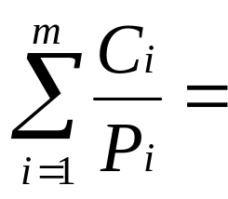
An Example
Consider the 3 Assignments A, B and C on Page 15.
    An assignment that takes 1 day to complete every 5 days.
    An assignment that takes 1.5 days to complete every 4 days.
    An assignment that takes 1 day to complete every 3 days.
The utilization for these 3 tasks is
(1/5 + 1.5/4 + 1/3) = 90.8% (which is < 100%)
That is A consumes 20%, B, consumer 37.5% and C consumes = 33.3% of CPU time.
Thus there is a possibility that this particular set of tasks will be able to meet their deadlines each and every time they are triggered, i.e. we haven’t ruled it out.
If assignment 3’s compute time were 1.5 days, the total CPU utilisation would be
(1/5 + 1.5/4 + 1.5/3) = 107% meaning it’s not possible for them to always meet their deadlines.

Slide 21
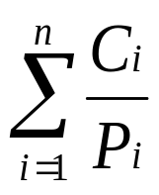
Liu and Layland went further and derived an equation that would allow us to pre-determine if a set of 'n' tasks could always meet their deadlines when we prioritise them correctly. Their analysis was based purely on CPU utilisation.
For 1 task the combined task set utilisation must not exceed 100%
For 2 tasks, the combined task set utilisation must not exceed 82.8 %
For 3 tasks, the combined task set utilisation must not exceed 77.97 %
As ‘n’ tends to infinity this means that the total CPU utilisation for a set of 'n' tasks must not exceed 69.3% (i.e. Log_{e}(2)) if we want to mathematically guarantee that all tasks will always meet their deadlines.
Important Note: If the combined utilisation is greater than the formula above suggests, it may still be possible to show they will always meet their deadline, but you would have to draw the time line graph to be able to show it. It cannot be proven mathematically.
Total Combined CPU Utilisation
must be <= n(2^{(1/n)} - 1)

Slide 22
22
Example Problem
Consider 3 tasks A, B and C each triggered periodically at intervals of 100, 200 and 300mS respectively.
If each of these tasks requires compute times of 20, 40 and 50mS respectively, then the sum of the compute/deadline times for these three tasks is:-
(20/100 + 40/200 + 50/300) = 56.7% (< 77.97%)
Thus Liu and Layland's equation is saying that this particular set of 3 tasks is guaranteed to always meet their deadlines each and every time.
Question
What if the utilisation of the 3 tasks is <100% but > 77.97%?
We cannot use the equation to determine/guarantee whether the set of tasks will meet their deadline – we have to resort to drawing a time line graph and do the analysis by hand – i.e. the long way.

Slide 23
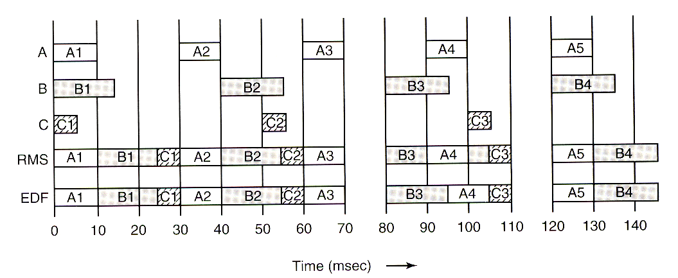
Approach 2: Drawing a Time Line Graph
The figure below shows 3 tasks A, B, C with compute times of 10, 15 and 5 mS
Their periods/deadlines are 30, 40 and 50ms respectively.
Utilisation is 80.5% (>77.97%) so L&L’s equation does not give us a conclusive answer.
If we schedule the tasks on the basis of shortest deadline = highest priority and use the idea of pre-emptive scheduling, it means that when task A wants to run, it can pre-empt either task B or C. Likewise B can pre-empt C but not A.
Assume all tasks are ready to run, i.e. released at the same time (the worst case scenario), but A, having the shortest deadline/highest priority, runs first.
Time ms
Utilisation is 80.5%
Time ms
A has the shortest deadline and is given the highest priority

Slide 24
Plotting the Time Line
A with highest priority runs first
After 10mS, (when A has finished), B runs, followed 15ms later by C which between them consume 30mS.
All meet their deadlines before A is triggered again at time = 30mS
This continues until the system becomes idle at time = 70mS.
Initially A with the highest priority is run first
Idle
Idle
Actual Task Scheduling using pre-emptive scheduling
Time ms

Slide 25
At t=80mS, B is triggered, however at t=90mS, A is triggered and pre-empts B until time t=100mS when C is also triggered. At this point the OS can either complete B or start C, so it chooses B based on priority. They are all still meeting their deadlines.
Questions
When would the above pattern of task activation repeat itself?
What would have happened if the compute time of C had been 6ms?
What would the CPU utilisation have been in this case?
What does this say about Liu and Layland's equation?
B runs for 3rd time
A Pre-empts B
Idle
Idle
B runs in preference to starting C due to B’s higher priority
Time ms

Slide 26
The pattern of activation will repeat worst case when you multiply the times together, thus they all start simultaneously again in 600ms i.e. when the 30ms pattern has repeated 20 times, the 40ms - 15 times and the 50ms - 12 times, i.e. integer multiples of their trigger times.
When the compute time of task ‘C’ (on page 25) was only 5ms, the utilisation was 80.5% and we saw from the graph that all 3 tasks met their deadlines.
However when the compute time of task ‘C’ it was increased to 6ms, the utilisation rose to 82.8% and yet they failed to meet their deadlines.
This is because the equation on page 21 is saying that if you exceed 77.97% (for 3 tasks) it cannot predict with certainty whether each task in the set will meet its deadline, but in practice it may still be possible.
If the CPU utilisation for a set of 'n' tasks is < 100% but > n(2^{(1/n)} - 1) then the only way to figure out if all tasks will actually meet their deadlines is to draw a timeline graph (as per page 24) until the pattern of task triggering repeats.
If all tasks meet their deadline within that time, then we can guarantee that they will always meet their deadlines – end of story. If any of them fails then you also have your answer.

Slide 27
Making it Happen in Practice - Rate Monotonic Scheduling (RMS)
The success of RMS depends the existence of a priority based, pre-emptable OS Kernel under which the tasks all run.
When a set of tasks is correctly analysed and assigned priorities (by you) it will guarantee the successful scheduling of those tasks (i.e. they meet their deadlines) subject to the following task assumptions/limitations.
  Each task is periodic i.e. is triggered at regular, fixed time intervals.
  All periodic tasks with deadlines run independently of each other, i.e. they cannot share resources or get blocked on say a mutex. (e.g. problem with Mars pathfinder)
  Each periodic task is deterministic, i.e. we can calculate its worst case compute time.
  Task swapping occurs in zero time.
  The total utilisation does not exceed the pre-defined value on page 21

Slide 28
How do we assign Priority to tasks?
The shorter the deadline, the higher a task’s priority should be. A simple scheme is to assign a priority to each task equal to the inverse of its trigger period (for worst case we assume deadline time = trigger period).
For example, a task that is triggered every 50mS (i.e. 20 times per second) should be assigned a priority of 1/50 = 20, likewise a task that is triggered every 20mS (i.e. 50 times per second) is assigned a priority of 1/20 = 50 etc.
(Note that the absolute priority values themselves are not important only their relative values, thus this formula is just a simple means of saying that tasks with shorter deadlines should be given a higher priority than tasks with longer deadlines.)
It follows that a real-time OS should be capable of supporting many different priority levels e.g. a 16 or 32 bit priority value is common – which Windows does not have.
When such a scheme is implemented in a pre-emptable priority based operating system, it ensures that the task with the shortest deadline (i.e. the task with the highest priority) will always be allowed to run in preference to other tasks with longer deadlines (i.e. lower priorities).
In summary, the shorter the task deadline, the higher its priority should be relative to other tasks with longer deadlines, thus, under this scheme each task is assigned a monotonically increasing (i.e. never decreasing) priority, based upon its rate of activation, which consequently affects OS scheduling, hence the name ‘rate monotonic scheduling’.

Slide 29
Summary
  If total utilisation is <= n(2^{(1/n)} - 1) all tasks will meet their deadlines, if we assign priorities based on deadlines and assume pre-emptive processing, so no additional work needs to be done.
  If total utilisation > 100% then the tasks will definitely fail.
  If total utilisation is >= n(2^{(1/n)} - 1) but < 100%, an analysis of the specific task set will be needed i.e. draw the execution time lines by hand, assign priorities based on deadlines and assume pre-emptive processing as we have seen here, and verify whether or not they will meet their deadlines within the repeating time period. If they do meet their deadline, this is also a guarantee, it's just one derived by observation rather than mathematical proof.
  When scheduling the tasks on a real-time, pre-emptive, priority base operating system, always assign priorities according to RMS (i.e. priority = 1/Deadline)

Slide 30
30
Harmonic Task Sets – An Interesting Anomaly
If the trigger times of each task in the set are an exact integer multiple of all other tasks that have a shorter trigger period, then we can guarantee that all tasks will meet their deadline provided the total task set utilisation <= 100%.
For example, a three-task set whose trigger periods are 20, 40, and 80ms, respectively, is ‘harmonic’, but the set of tasks with trigger periods of 20, 50, and 90ms is not harmonic.
However changing periods/deadlines to meet this objective may be out of our control, as the trigger periods may be dictated by the requirement of the real world and the problems we are solving with our tasks.
Of course you could always buy a faster CPU to reduce task compute times and hence lower overall utilisation to the point where mathematics says they will succeed !!

Slide 31
Illustration of the successful scheduling of 3 harmonic tasks with 100% utilisation
No Idle Time
Compute time = 5ms Deadline = 20ms
Utilisation = 25%
Compute time = 10ms Deadline = 40ms
Utilisation = 25%
Compute time = 40ms Deadline = 80ms
Utilisation = 50%
A
B
C
10
20
30
40
50
60
70
80
90
100
110
120
130
140
150
160
170
180
190
200
Repeating pattern of scheduling for tasks with harmonic deadlines
Repeating pattern of scheduling for tasks with harmonic deadlines
Repeating pattern of scheduling for tasks with harmonic deadlines
Example scheduling of 3 task with harmonic deadlines of 20, 40 and 80 ms respectively.
The sum of compute/deadline times for all tasks is such that there is no idle time and utilisation is 100%.
All Tasks meet their deadline.
The GREEN task comes closest to failure as it always completes just prior to being triggered again. The reason why it works up to 100% utilisation with harmonic tasks is that the pattern of scheduling is repetitive. That is, task scheduling requirements for each task do not vary w.r.t each other after all tasks have completed one deadline period (at 80ms when C repeats).
If the compute time of the BLUE task were reduced to 5ms, what would be the utilisation? Can you plot the graph? Would all tasks still meet their deadlines?

Slide 32
Other Scheduling Approaches -EDF
Even though other scheduling approaches, such as Earliest Deadline First (EDF) https://en.wikipedia.org/wiki/Earliest_deadline_first_scheduling can be used for Real time systems, the big attraction of using RMS are
  Priorities are fixed and never change, thus scheduling and task swapping is both simpler and faster – requiring nothing more than a priority based pre-emptive OS scheduler (common in RT OS’s).
  (EDF by comparison requires a queue of processes be searched for the one with the next shortest deadline, each time a task swap occurs, and then dynamically change its priority to ensure it is scheduled to run next)
  Should overload of the processor occur, it will always be the lowest priority task that fails first, (e.g. task C on page 25 when its compute time was raised from 5ms to 6ms) leaving higher priority tasks to succeed.
  (With EDF it is not possible to predict which task will fail when the CPU becomes overloaded.)
RMS’s main drawback compared to EDF is that it is less optimal in that EDF guarantees successful scheduling (i.e. the meeting of deadlines) for CPU utilisation as high as 100%.
RMS’s success on the other hand is limited to utilisation not exceeding 69.3% (Log_{e}2) for an infinite number of tasks. Nevertheless the other advantages of RMS listed above mean it is the most popular scheduling approach for real-time systems.

